Slide 1


Slide 2

CHAPTER 10
Error Detection and Correction
4-1

Slide 3
Data can be corrupted during transmission.
Some applications require that errors be detected and corrected.
Error detection and correction are implemented either at the data link layer or the transport
layer of the OSI model.

Slide 4
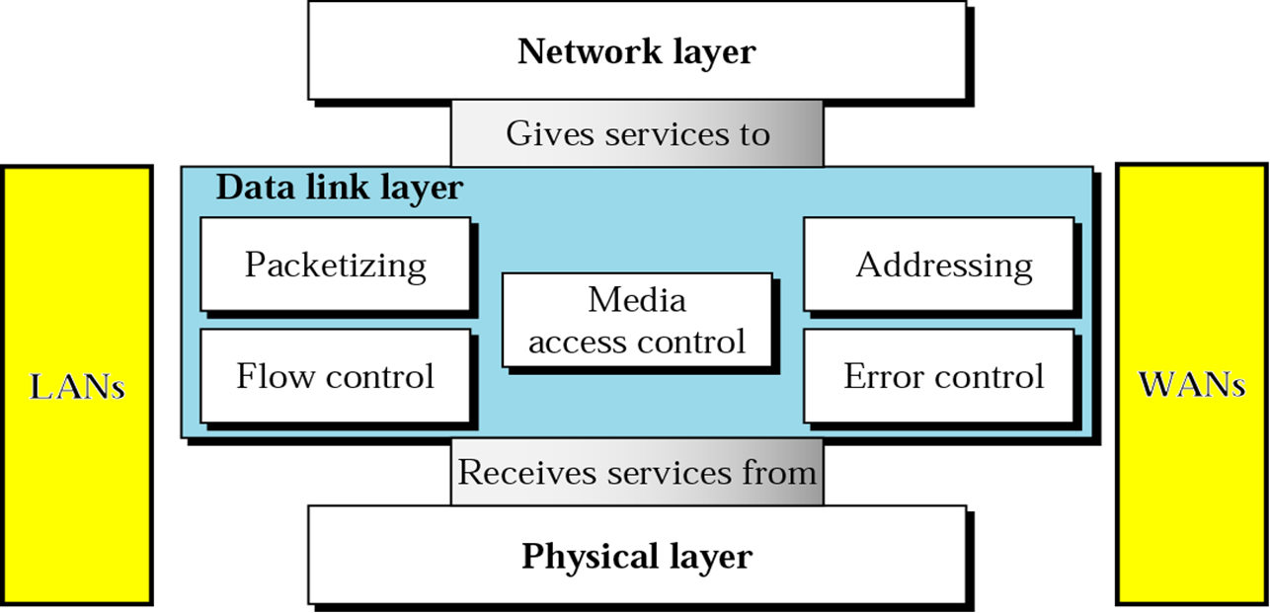

Data Link Layer

Slide 5
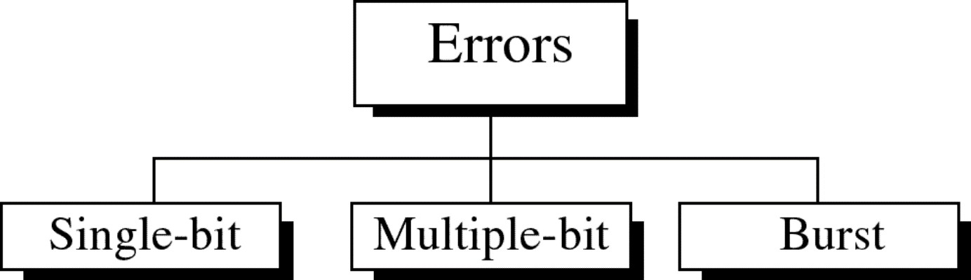

Slide 6

Single-bit error
In a single-bit error, only 1 bit in the data unit has changed.

Slide 7
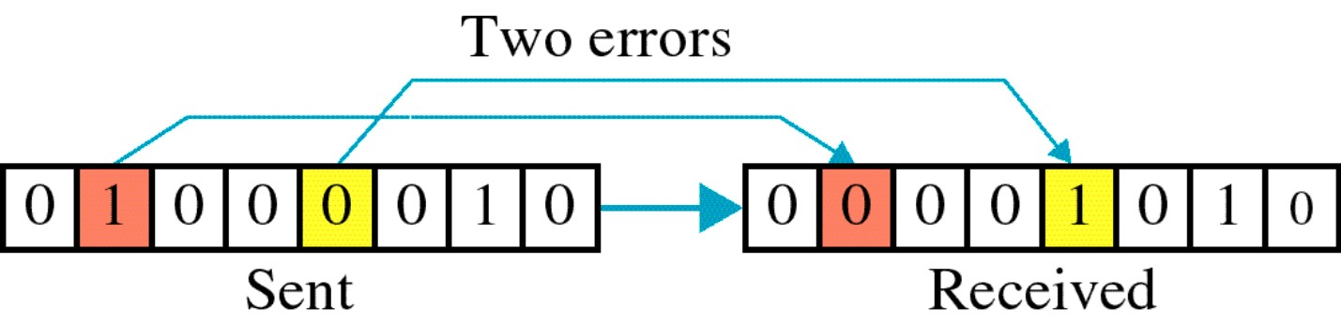
Multiple-bit error

Slide 8
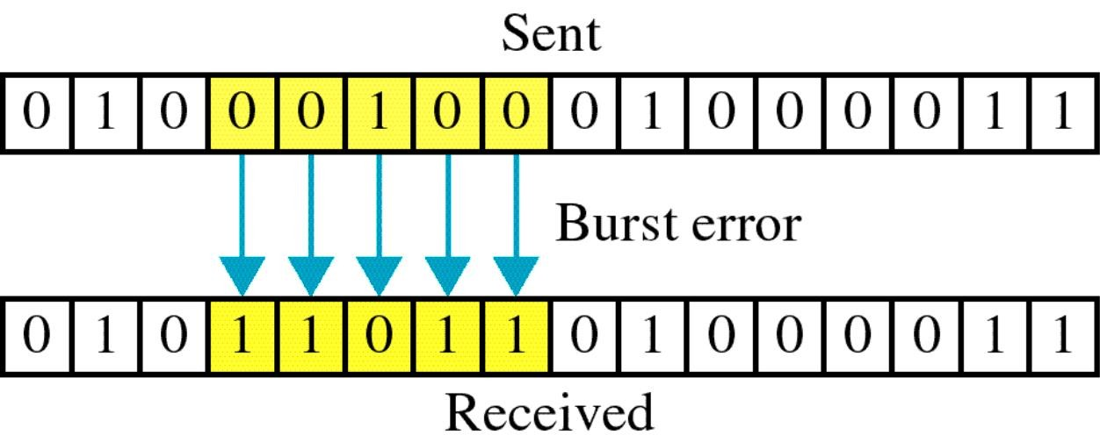
Burst Error

Slide 9
Redundancy
The central concept in detecting or correcting errors is redundancy
To detect or correct errors, we need to send extra (redundant) bits with data

Slide 10
Error Detection
In error detection, we are looking only to see if any error has occurred. The answer is a simple yes or no. We are not even interested in the number of errors.

Slide 11
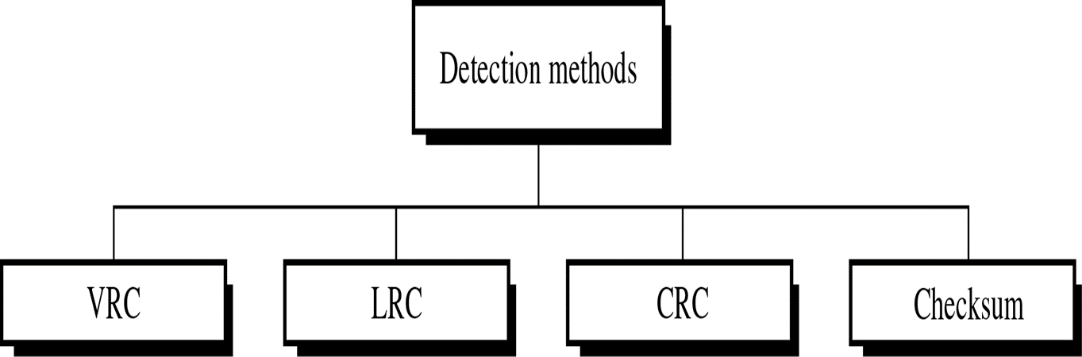

Slide 12
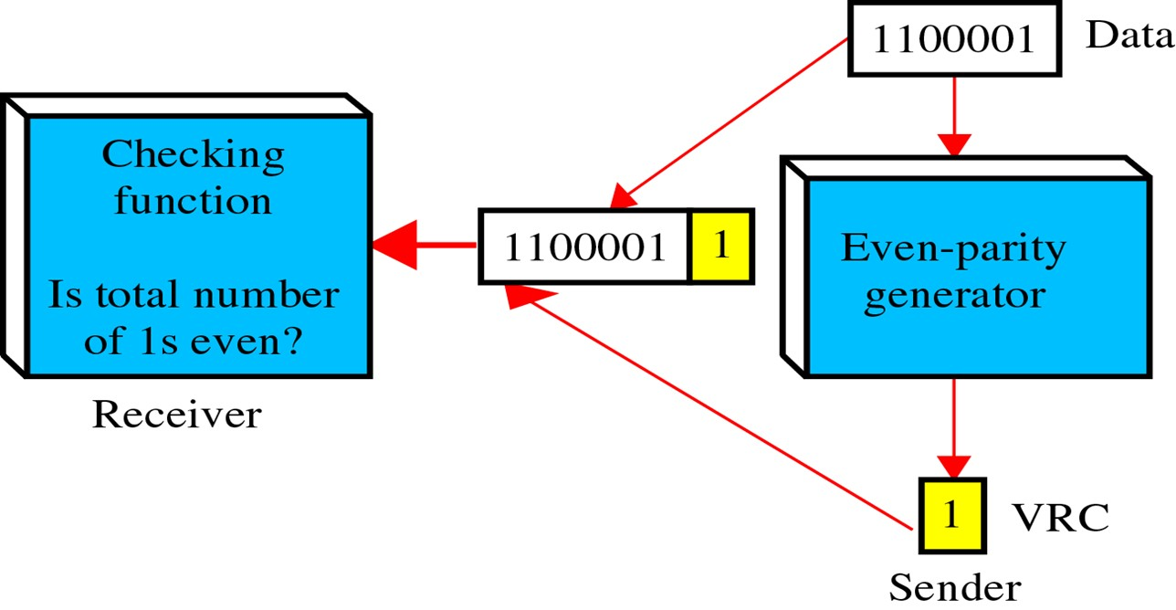
Vertical Redundancy Check
VRC called a Parity Check
A parity bit is added to every data unit
Even-parity checking or odd-parity checking

Slide 13
Example
Sender wants to send “world” In ASCII, the five characters are coded as:
1110111 | w 1110111 0
1101111 | o 1101111 0
1110010 | r 1110010 0
1101100 | l 1101100 0
1100100 | d 1100100 1

Slide 14
Receiver Side
Suppose “world” is received by the receiver corrupted:
1110111 | w | 1111111 0 | 7
1101111 | o | 1101111 0 | 6
1110010 | r | 1110110 0 | 5
1101100 | l | 1101100 0 | 4
1100100 | d | 1100100 1 | 4
Receiver counts the 1’s and rejects it because of Odd parity generator

Slide 15
Performance of VRC
VRC can check all single-bit errors
It can not detect errors if the total number of errors is even
We have an Even Parity data unit where the total number of 1’s including the parity bit is ‘6’ : 1000111011
If 3 bits change value resulting parity will be odd and an error will be detected: 1111111011: 1’s = 9
VRC cannot detect errors when the total number of bits changed are even

Slide 16
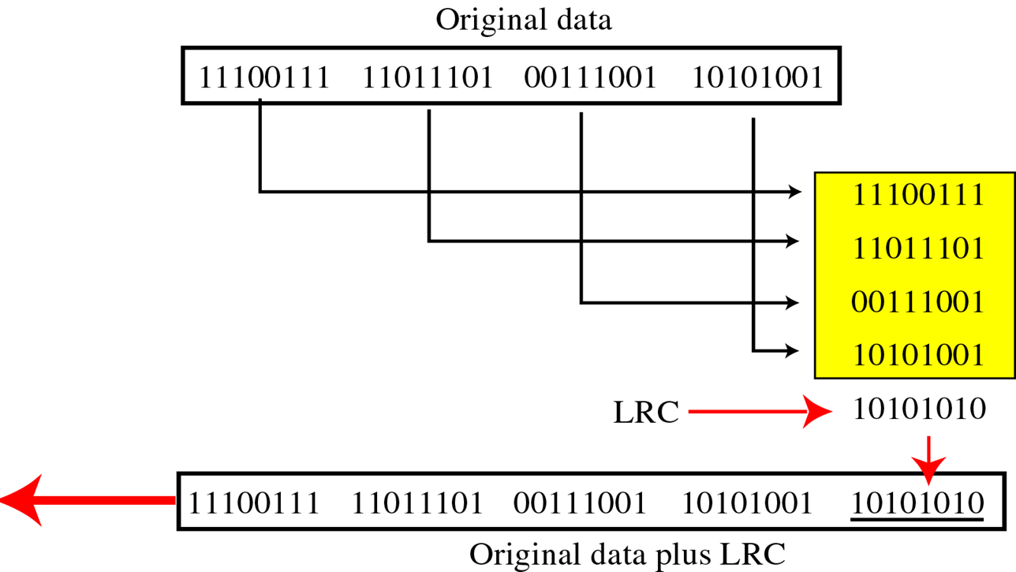
Longitudinal Redundancy Check
A block of bits is divided into rows and a redundant row of bits is added to the whole block

Slide 17
Example
Sender Side
Suppose the following block is sent:
1 0 1 0 1 0 0 1
0 0 1 1 1 0 0 1
1 1 0 1 1 1 0 1
1 1 1 0 0 1 1 1
1 0 1 0 1 0 1 0 (LRC)

Slide 18
At the Receiver Side
Receiver checks LRC, some of bits do not follow even parity rule and whole block is discarded
10100011
10001001
11011101
11100111
10101010 (LRC)

Slide 19
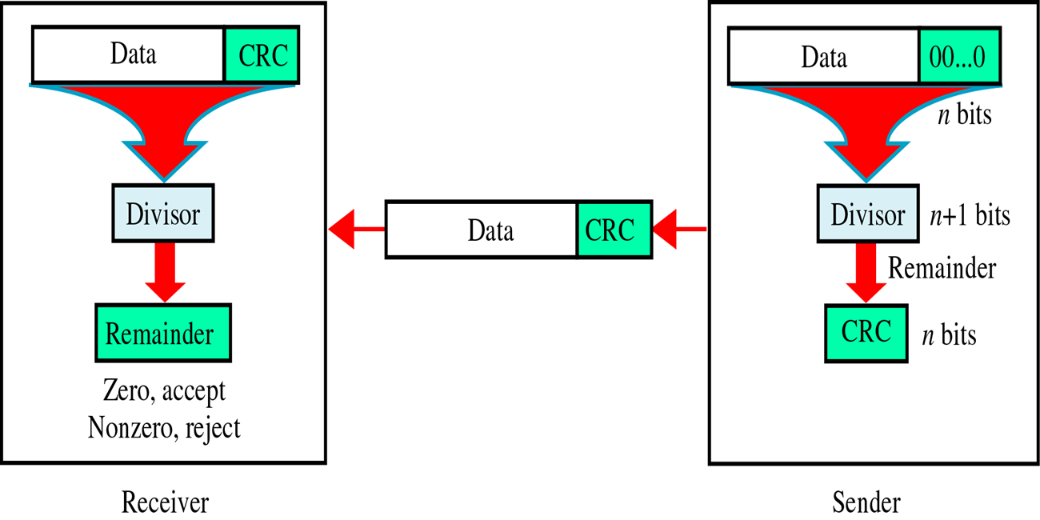
Cyclic Redundancy Check
Uses binary division

Slide 20
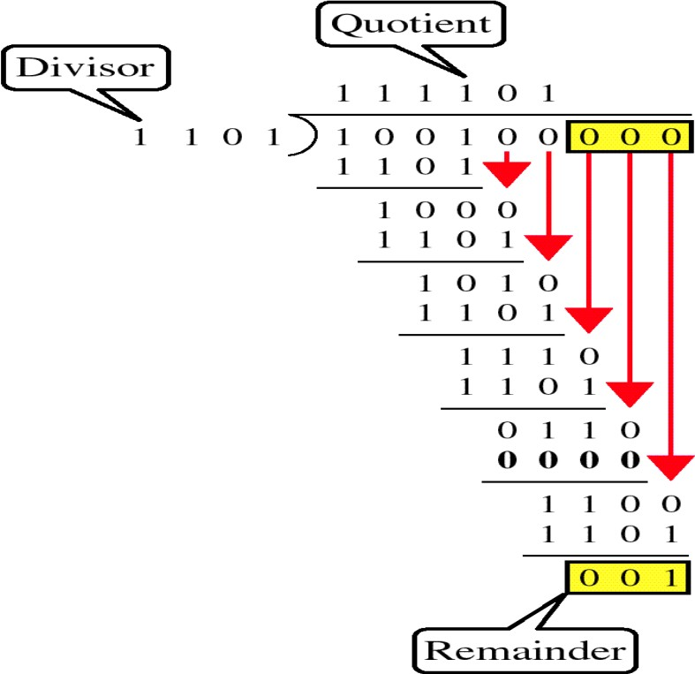

Slide 21
Performance of CRC
CRC can detect all burst errors
CRC can detect with a very high probability burst errors of length greater than the degree of the polynomial

Slide 22
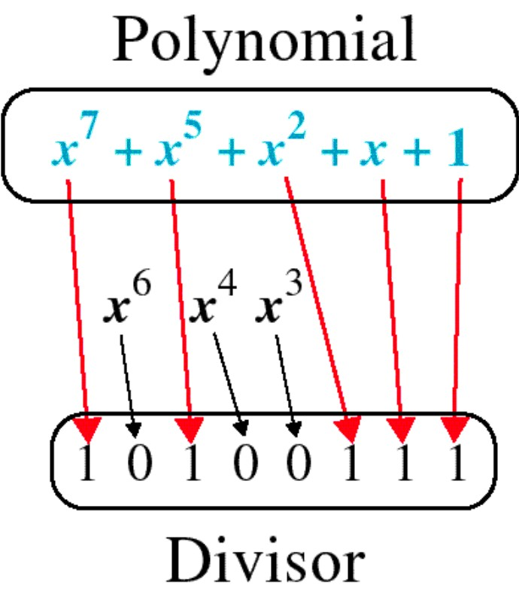
Polynomial and Divisor

Slide 23
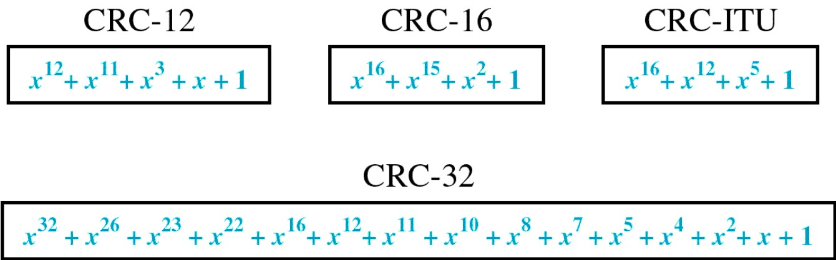
Standard Polynomials

Slide 24
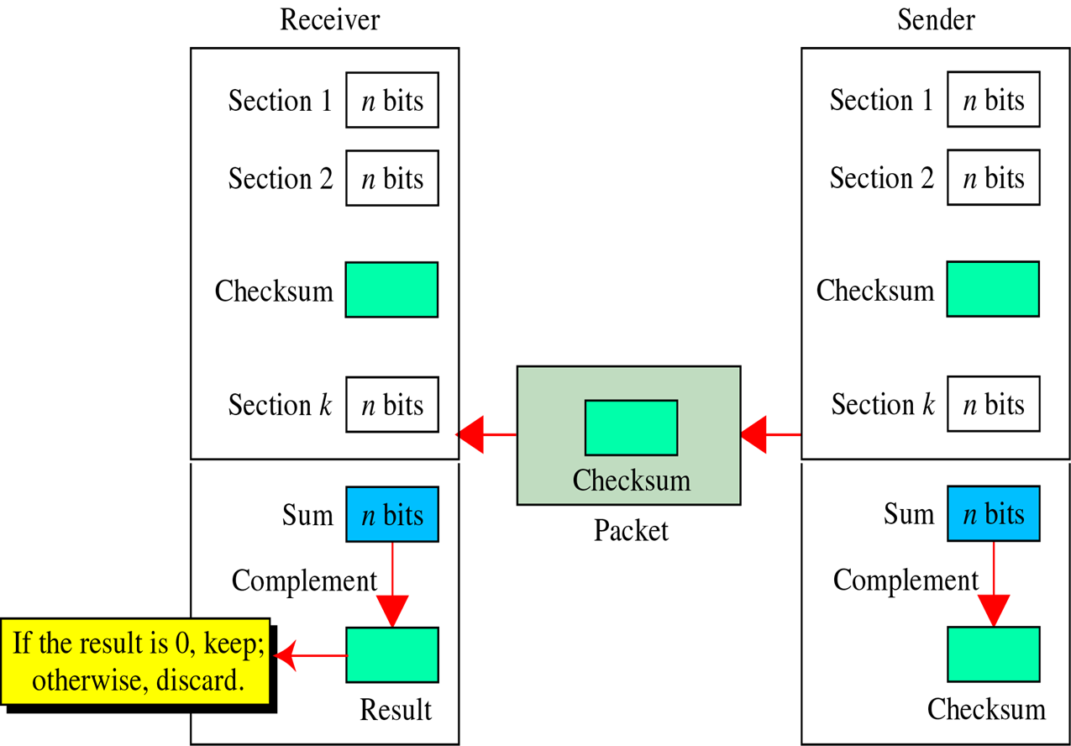
Checksum
Error detection method used by the higher layers
All sections are added and complemented to get the checksum, using one’s complement arithmetic

Slide 25
Performance of Checksum
Detects all errors involving an odd number of bits
Detects most errors involving an even number of bits
One pattern remains elusive
Suppose a block of 16 bits need to be sent: 00111001
10101001
00111001
----------------
10101001
11100010 Sum
00011101 Checksum Sent pattern:
10101001 00111001 00011101
checksum

Slide 26

Hamming Code

Slide 27
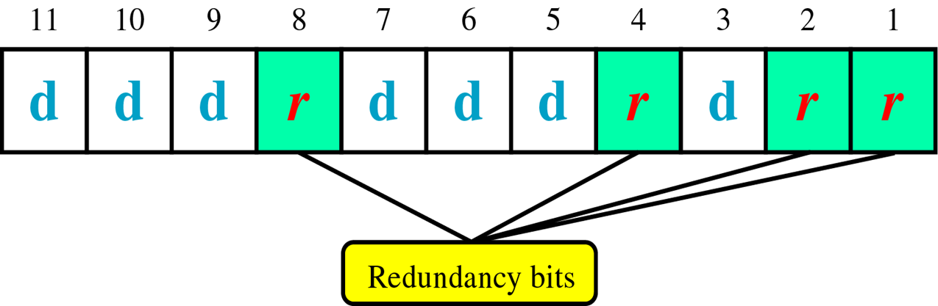
Hamming Code

Slide 28
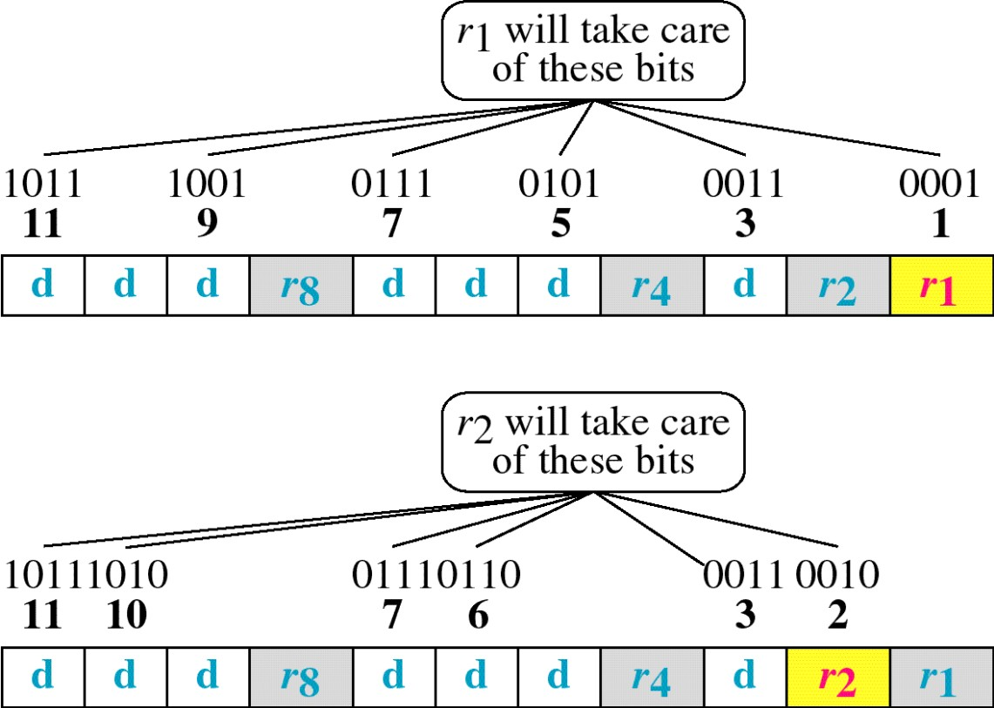
Redundant Bit Calculation

Slide 29
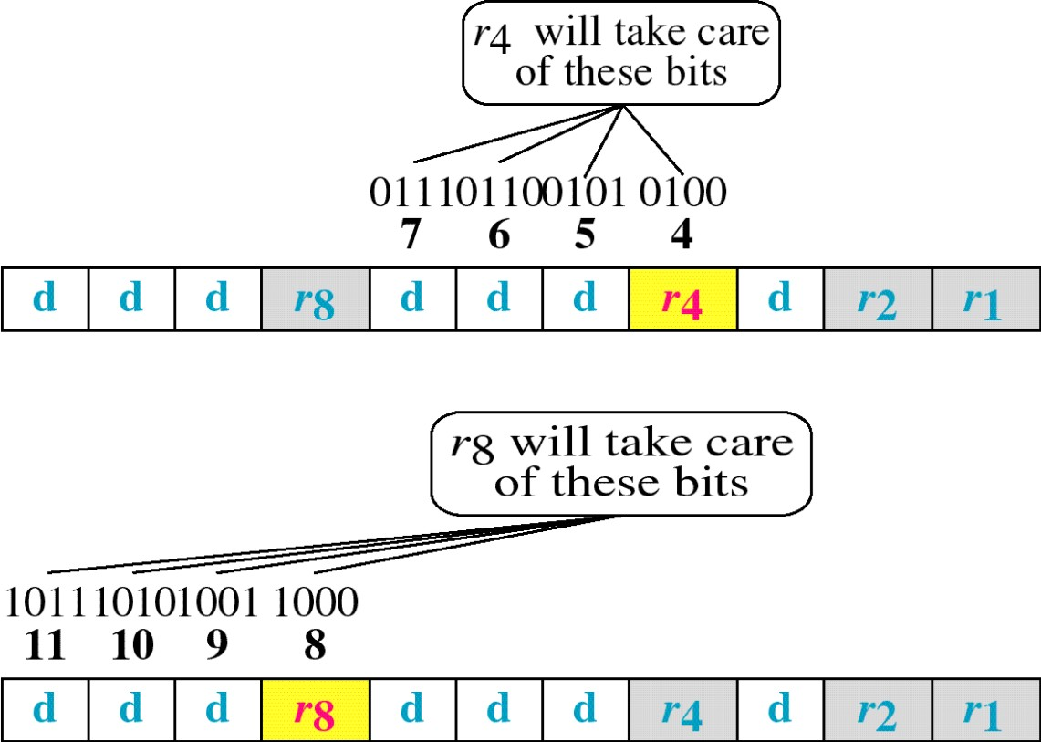

Slide 30
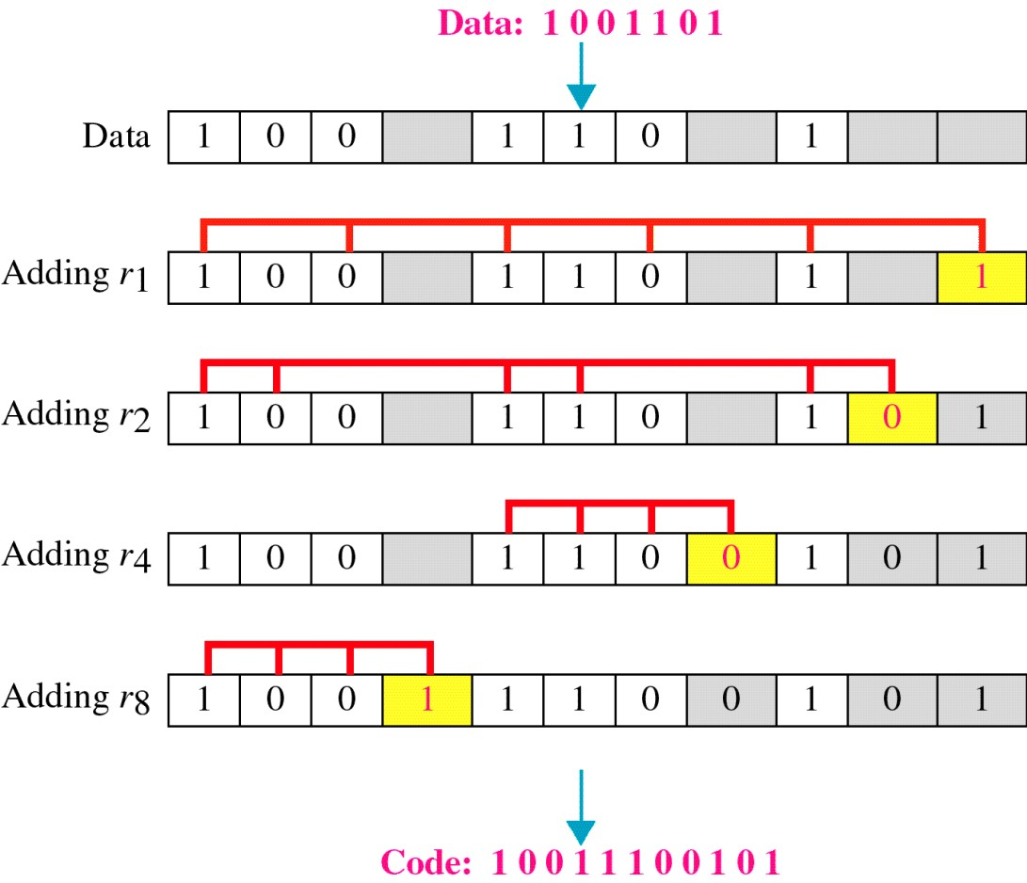

Slide 31
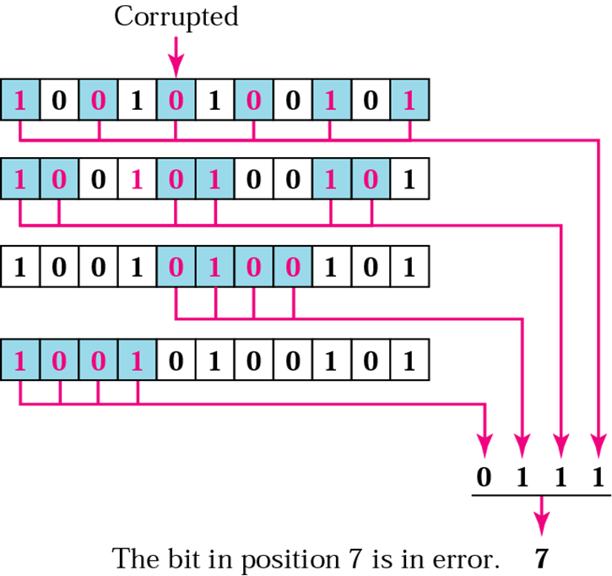
Example: Correcting Error
Receiver receives 10010100101

Slide 32
Thank you

